Slide 1



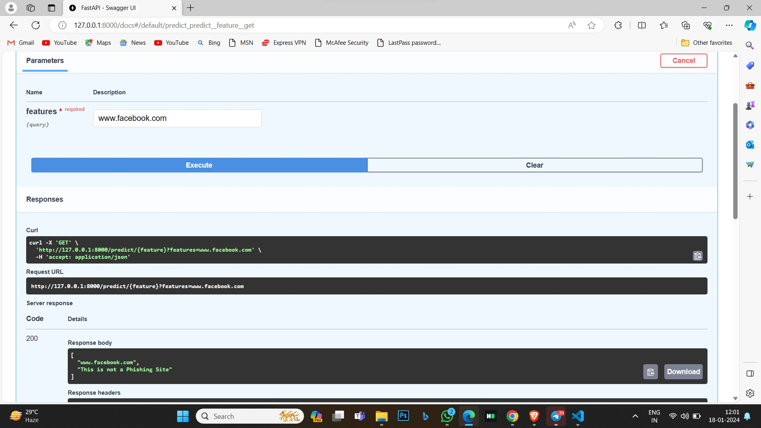
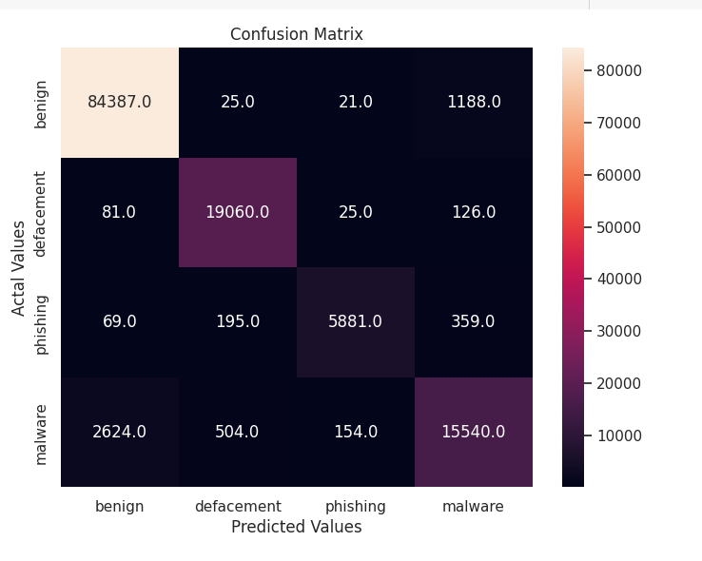
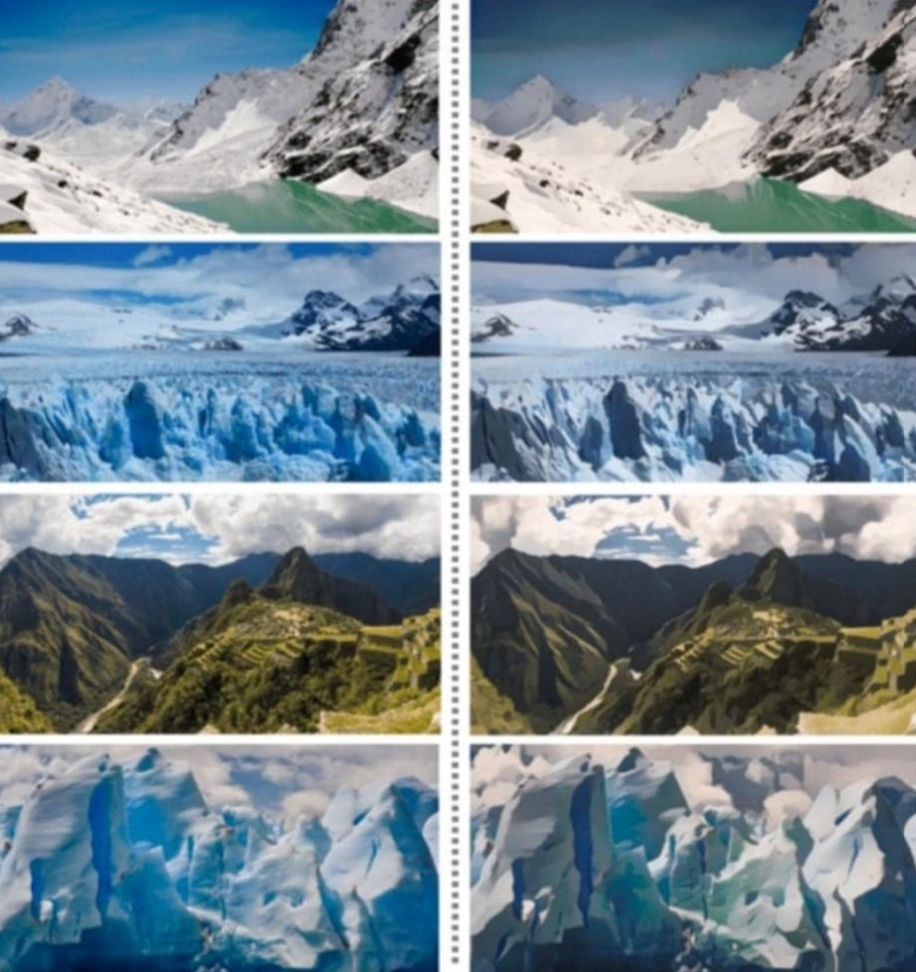
CARTOONIFY AN IMAGE WITH OPENCV”
Department of Computer Science & Engineering
School of Computing
10214CS602– MINOR PROJECT-2
WINTER SEMESTER 2023-2024
ABSTRACT
INTRODUCTION
RESULTS
STANDARDS AND POLICIES
This project proposes to converting a normal images to cartoon Image using Generative Adversarial Networks. we will use GANs to generate cartoonified versions of input images using the OpenCV library. Nowadays , Cartoonifing the images are necessary as well as useful for many aspects in various sectors of the world. There are number of ways to convert an normal image to cartoon but among all of them using GAN is finest and uncomplicated. OpenCV is an open - source Python Library used for computer vision and Machine Learning. It includes applications such as video and image capturing and processing. It is majorly used in image transformation , and many more.
Cartoonify an image is a technique that has gained a lot of popularity in recent
years. It involves transforming a regular photograph or image into a cartoon-like
representation, which simplifies the colors and emphasizes the edges, giving it a
hand-drawn appearance. This technique is widely used in various fields, such as
video games, animation, and movies . GAN is a popular computer vision library that
provides tools and functions for image processing and analysis. It is widely used in
various applications, including object detection, facial recognition, and image
segmentation. In this project, we focus on using GAN to create a cartoon-like
representation of an input image.
The proposed approach consists of several steps, including edge detection, color quantization, and image filtering. The edge detection step involves identifying the edges in the image using Canny edge detection. Next, the color quantization step reduces the number of colors in the image using k-means clustering. Finally, a bilateral filter is applied to smooth the image while preserving the edges .
The resulting output image resembles a cartoon by simplifying the colors and emphasizing the edges, giving it a hand-drawn appearance.
The system which was proposed by us is the efficient in many ways to cartoon
the real pictures And the technique used to build the software is so cost less as well
as easy to build just some good effort is needed. GAN can be the best choice for us
to choose to cartoonify the images because even it is hard to build but it gives the
results accurately and effectively . As we can implement many types of datasets on
this system.
The main thing to compare between the existing and our system is the technique
used to build the software. they used the regular techniques to cartoonize but we
had changed it by introducing GAN to build a software which can give more
Outputs . Time consuming is less compared to the old systems . the clarity and edge
has been developed using some more properties.
Data Privacy and Protection: Adherence to data privacy regulations such as the General Data Protection Regulation (GDPR) in the European Union and the California Consumer Privacy Act (CCPA) in the United States is essential. This involves ensuring that user data used for training and testing the machine learning model is handled in a compliant and ethical manner.
Ethical AI Principles: Following ethical AI principles and guidelines, such as those outlined by organizations like the IEEE or the European Commission's High-Level Expert Group on Artificial Intelligence, can help ensure that the machine learning model is developed and used in an ethical manner.
Figure 1. Label in 20pt Calibri.
Figure 2. Label in 20pt Calibri.
CONCLUSIONS
METHODOLOGIES
Many Companies analyzed that Advertising their products using Cartoon images
will helps them to attract people. Nowadays many schools are introducing
Cartoonified books to the children. As in the World which is rapidly Increasing
Technology Cartoonizing plays a great role in various aspects. Nowadays, Cartoons
are used primarily for conveying political commentary and editorial opinion in
Newspapers and also used in social comedy and Magazines. Thus our project helps
various sectors which includes cartoonization . It is important to preprocess the
image before applying any filter or effect. This includes resizing the image to a
smaller size, converting it to grayscale, and smoothing it to remove any noise or
unwanted details. By carefully considering each step and its impact on the image, it
is possible to create a wide range of unique and interesting cartoon-style
images using OpenCV.
TEAM MEMBER DETAILS
Data Collection: I will collect a dataset of phishing and legitimate URLs from publicly available sources like PhishTank, OpenPhish, etc. The data will be cleaned by removing duplicates and null values.
Model Building: I will split the dataset into train and test sets. I will then train and tune machine learning models like Logistic Regression, Random Forest, and XGBoost on the training set. The model with the best performance on the validation set will be selected as the final model.
Evaluation: The performance of the final model will be evaluated on the test set using metrics like Accuracy, Precision, Recall and F1-score. The goal is to achieve over 95% accuracy in detecting phishing websites.
Prediction: The trained model can be used to predict if new unseen URLs are phishing or legitimate. This model can potentially be integrated into web browsers and search engines to detect phishing websites in real-time.
<Student 1. K.ROHITH CHOWDARY>
<Student 2 .K.VINAY KRISHNA>
<Student 3 .D.VENKATESH>
<Student 1. 7396690289>
<Student 2. 8885144411>
<Student 3. 9794419036>
<Student 1. vtu19134@gamil.com>
<Student 2. vtu20388@gamil.com>
<Student 3. vtu20424@gamil.com>
ACKNOWLEDGEMENT
Mr.K.NAVAZ,M.E., Ph. D.,
Contact No : 8608245565
Mail ID :- NAVAZ.K@veltech.edu.in
Chart 1. Label in 20pt Calibri.

